Slide 1
SVR Estimation
Suraj Pawar

Slide 2
Algorithm used – Extended Kalman Filter

Slide 3
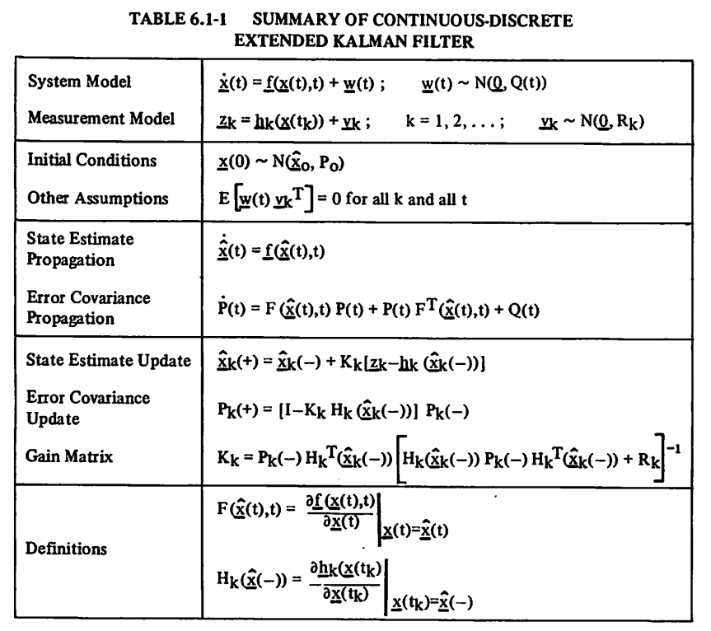
Model states and error covariance propagation
Measurement update

Slide 4
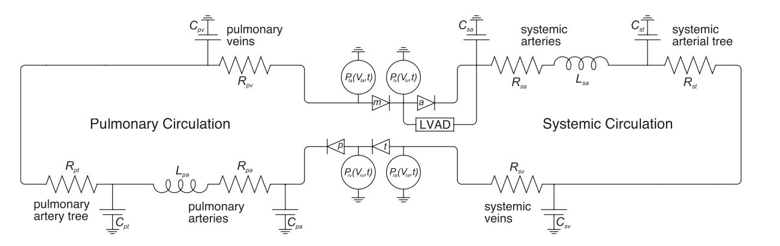
12-state model of CVS
Commonly referred to as
“Jeff” model in subsequent
figures

Slide 5
Issues with running EKF on 12-state model
EKF with 12 states may be complex, and hence computationally expensive
Huge KG matrix, P matrix
Hence, we needed to use a reduced order model.

Slide 6
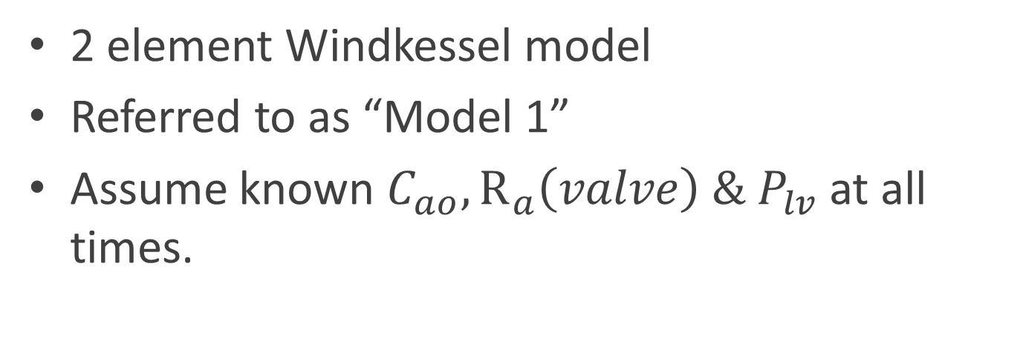
First attempt for reduced order model
2 element Windkessel model
Referred to as “Model 1”
Assume known $C_{ao}, R_{a}\left(valve\right) \& P_{lv}$ at all times.

Slide 7
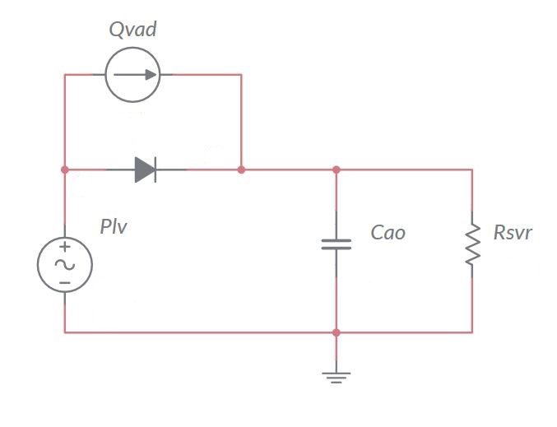

First attempt – 2 element windkessel
Noisy measurements
from the TORVAD
$$ΔP$$
To be estimated
Sinusoidal (simulated)

Slide 8
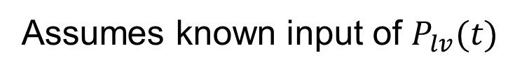

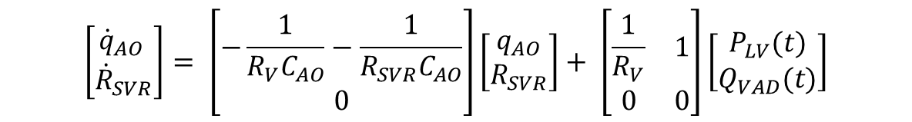
Assumes known input of $P_{lv}(t)$
$\left[{\dot{q}}_{AO}\right]= \left[\begin{matrix}−\frac{1}{R_{V}C_{AO}}−\frac{1}{R_{SVR}C_{AO}}\end{matrix}\right]\left[\begin{matrix}q_{AO}\end{matrix}\right]+ \left[\begin{matrix}\frac{1}{R_{V}} & 1\end{matrix}\right]\left[\begin{matrix}P_{LV}(t) \\ Q_{VAD}(t)\end{matrix}\right]$
$\left[ΔP\right]=\left[\begin{matrix}−\frac{1}{C_{AO}}\end{matrix}\right]\left[\begin{matrix}q_{AO}\end{matrix}\right]+\left[\begin{matrix}1 & 0\end{matrix}\right]\left[\begin{matrix}P_{lv}(t) \\ Q_{VAD}(t)\end{matrix}\right]$
Measurement Equation
Augmented system to include parameter to estimate as state
$$\left[\begin{matrix}{\dot{q}}_{AO} \\ {\dot{R}}_{SVR}\end{matrix}\right]= \left[\begin{matrix}−\frac{1}{R_{V}C_{AO}}−\frac{1}{R_{SVR}C_{AO}} \\ 0\end{matrix}\right]\left[\begin{matrix}\begin{aligned}q_{AO} \\ R_{SVR}\end{aligned}\end{matrix}\right]+ \left[\begin{matrix}\frac{1}{R_{V}} & 1 \\ 0 & 0\end{matrix}\right]\left[\begin{matrix}P_{LV}(t) \\ Q_{VAD}(t)\end{matrix}\right]$$

Slide 9
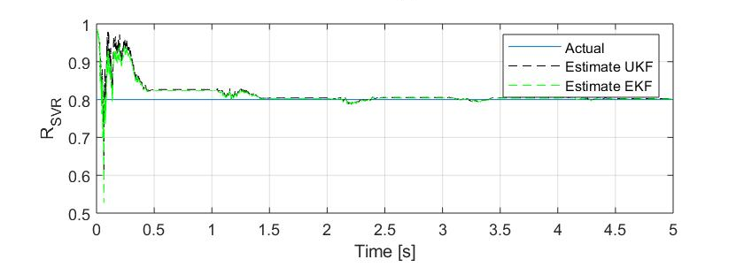

Model 1 $R_{svr}$ estimation (From Ethan)

Slide 10
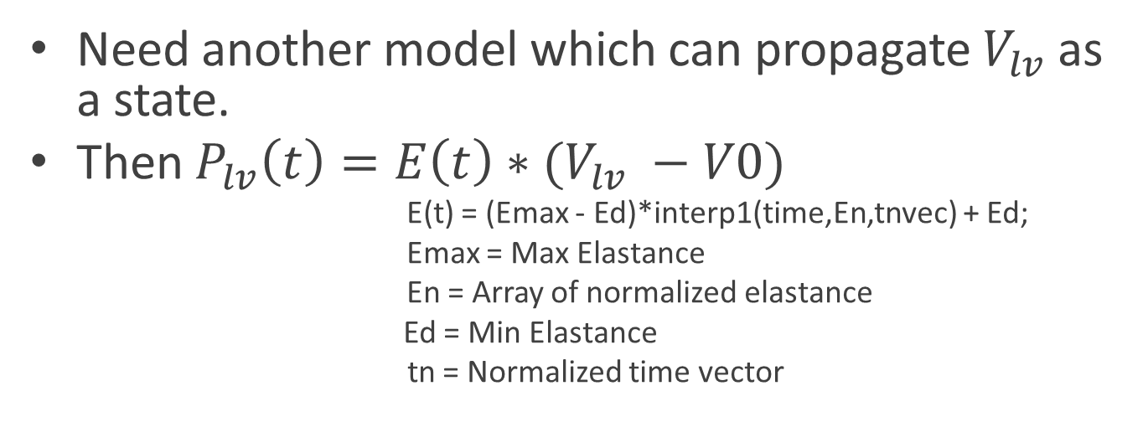

What if $P_{lv}$ unknown ?
Need another model which can propagate $V_{lv}$as a state.
Then $P_{lv}\left(t\right)=E\left(t\right)∗(V_{lv} −V0)$
E(t) = (Emax - Ed)*interp1(time,En,tnvec) + Ed;
Emax = Max Elastance
En = Array of normalized elastance
Ed = Min Elastance
tn = Normalized time vector
! Note : We are still assuming that Emax, Ed is known, but likely this information can be
Calibrated by nurse / doctor during patient’s visit to clinic. Can then reset the estimator accordingly.
Else, can be estimated in future as well.

Slide 11
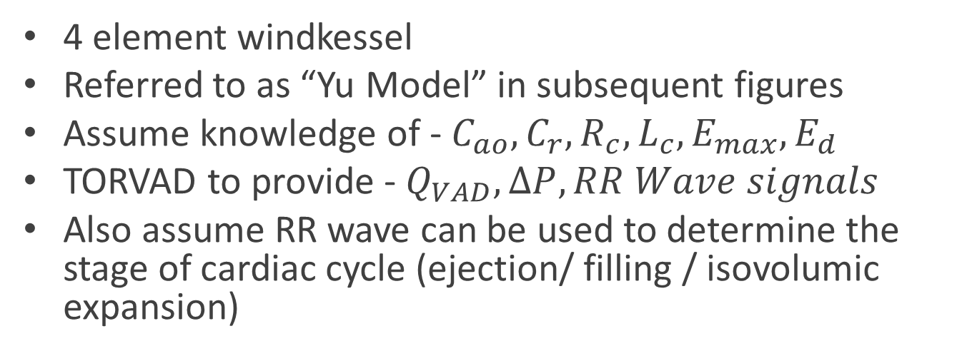
Propose new model
4 element windkessel
Referred to as “Yu Model” in subsequent figures
Assume knowledge of - $C_{ao}, C_{r}, R_{c}, L_{c}, E_{max}, E_{d}$
TORVAD to provide - $Q_{VAD}, ΔP, RR Wave signals$
Also assume RR wave can be used to determine the stage of cardiac cycle (ejection/ filling / isovolumic expansion)
Is this fair to assume ?

Slide 12
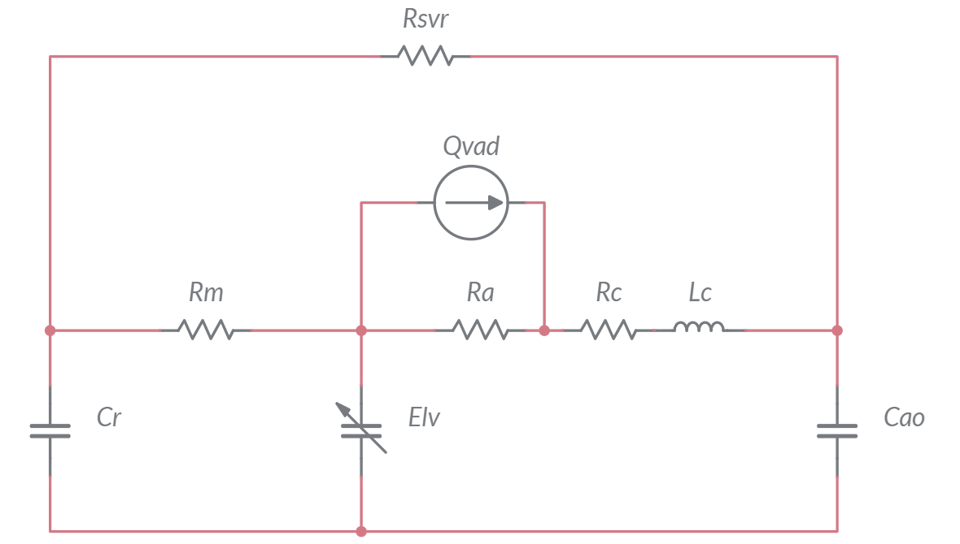


To be estimated
Noisy measurement
from TORVAD
$$ΔP$$
$$P_{lv}\left(t\right)=E_{lv}(t)(V_{lv}−V_{0})$$

Slide 13
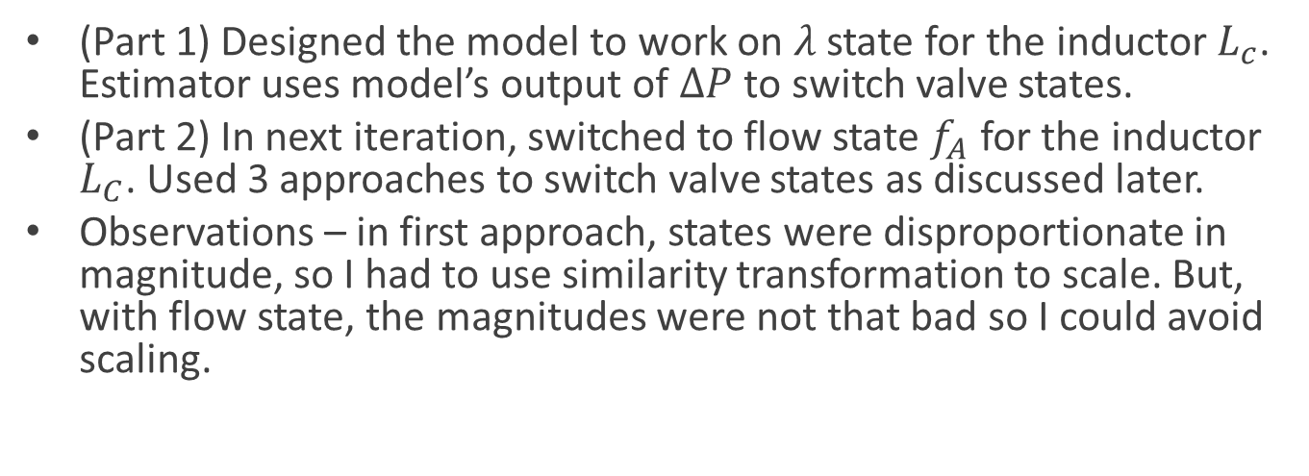
Iterations for testing
(Part 1) Designed the model to work on $λ$ state for the inductor $L_{c}$. Estimator uses model’s output of $ΔP$ to switch valve states.
(Part 2) In next iteration, switched to flow state $f_{A}$ for the inductor $L_{C}$. Used 3 approaches to switch valve states as discussed later.
Observations – in first approach, states were disproportionate in magnitude, so I had to use similarity transformation to scale. But, with flow state, the magnitudes were not that bad so I could avoid scaling.

Slide 14
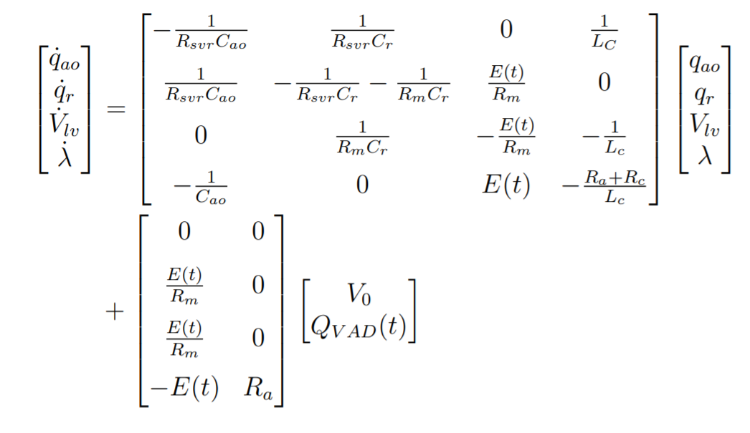

Part 1 of results – Using $λ$ as inductor state
State Equations

Slide 15
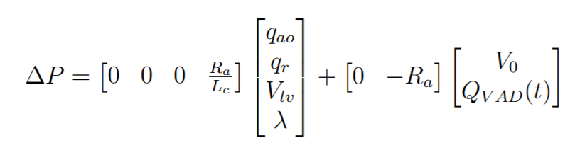

Part 1 of results – Using $λ$ as inductor state
Output Equation

Slide 16
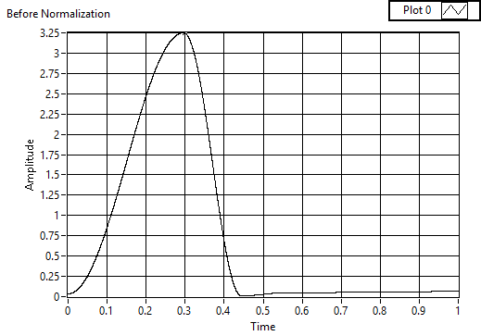
Left Ventricle Elastance (LUT)
Emax
Elastance of LV used for simulation.
Steps used to get this curve :
Run Jeff model with HR = 60 bpm
Get PLV as output
Assume this PLV = E*(VLV – V0)
Get E curve as PLV/(VLV – V0)
This curve is then normalized
in magnitude. Now you have
normalized time scale, and normalized
magnitude
Ed

Slide 17
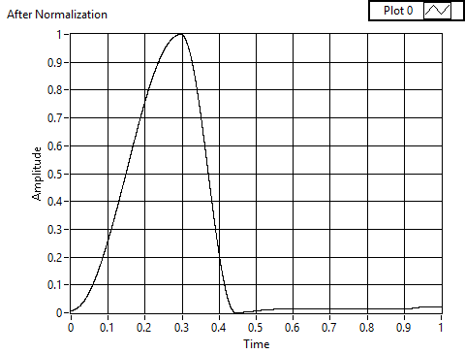
After normalization.
Code segment that uses this
curve to generate the Elastance
To use in every timestep in next slide

Slide 18
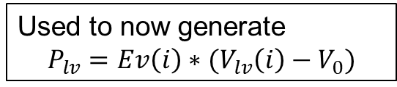
%% load ELV curve (following Yu and Avonzollini's approach)
ELVn = load('From_CVS_Normalized_E.mat');
time = ELVn.time;
En = ELVn.Enorm;
tmax0 = 0.2957; % Time where Emax occurs. See on ELV vs t graph of one cycle with HR = 60bpm.
Emax0 = 3.25; % Jeff's code
Emax = Emax0;
Ed0 = 0.006655; % Guess from Jeff's paper
Ed = Ed0;
tc = 60/HR;
RR = tc;
ts = 0.07+0.3*tc; % systolic tirne interval, tuned in LabVIEW using Analysis_ELV_From_CVS.vi
% ts = 0.16+0.3*tc; % Avonzollini's equation mentioned in Yu's dissertation
% ts = (1/1000)*(550 - 1.75*HR) % From Jeff's code
TLV = ts;
iter = 3; n = length(t);
tnvec = zeros(size(t));
tic
for k = 1:n
t1 = rem(t(k),tc);
if t1 <= ts, tn = tmax0*(t1/ts); else; tn = tmax0 + (1-tmax0)*(t1-ts)/(tc-ts); end;
tnvec(k) = tn;
end
Ev = (Emax - Ed)*interp1(time,En,tnvec) + Ed;
toc
Used to now generate
$$P_{lv}=Ev\left(i\right)∗(V_{lv}\left(i\right)−V_{0})$$

Slide 19
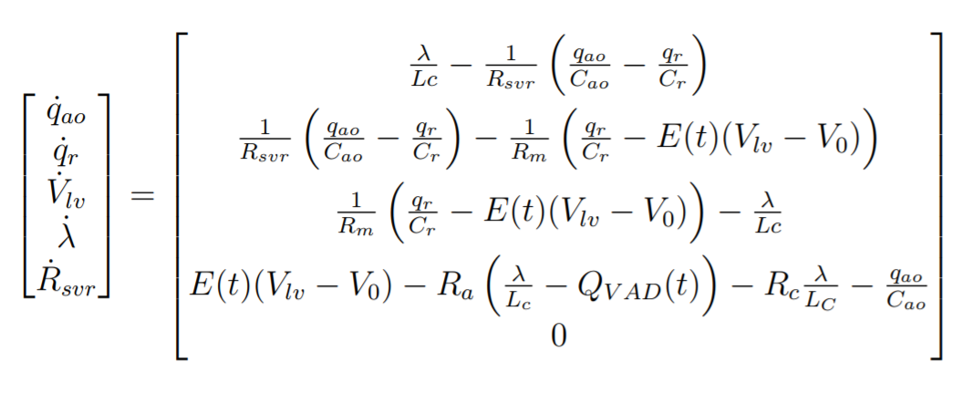
State Augmentation – non linear system

Slide 20
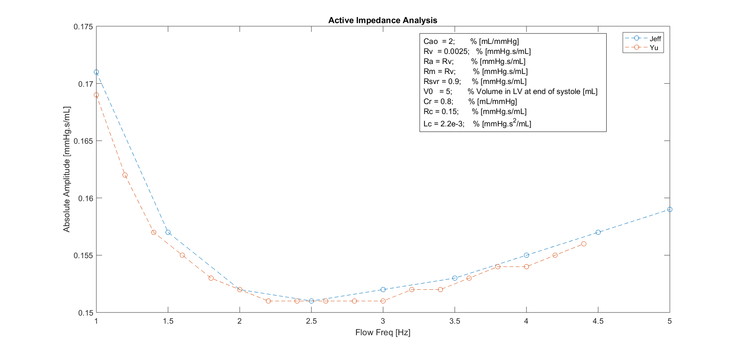
Selecting model parameters - Impedance
Procedure for impedance calculations
Run Jeff model at various HR, record Pa and fa.
Run Yu model at various HR, record Pa and fa
Derive mag of |Pa / fa| and compare.
Tune Yu parameters to match impedance
Note, although Jeff’s model has this rise towards the end, Yu’s dissertation shows human data which flattens down towards the end. Maybe depends on the subject, but can ponder more on this later

Slide 21
Strategy for open and closing valves
To simulate Aortic valve closed, Ra = 2e3 * Ra
To simulate Mitral valve closed, Rm = 2e3* Rm

Slide 22
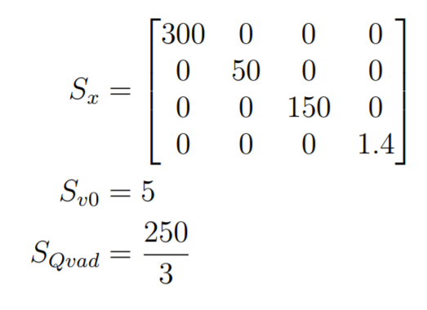
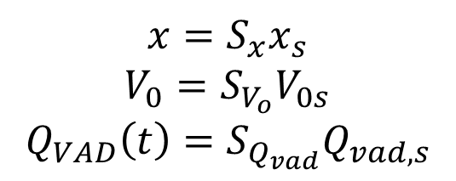
Scaling done to Yu model
$$x=S_{x}x_{s}$$
$$V_{0}=S_{V_{o}}V_{0s}$$
$$Q_{VAD}\left(t\right)=S_{Q_{vad}}Q_{vad,s}$$

Slide 23
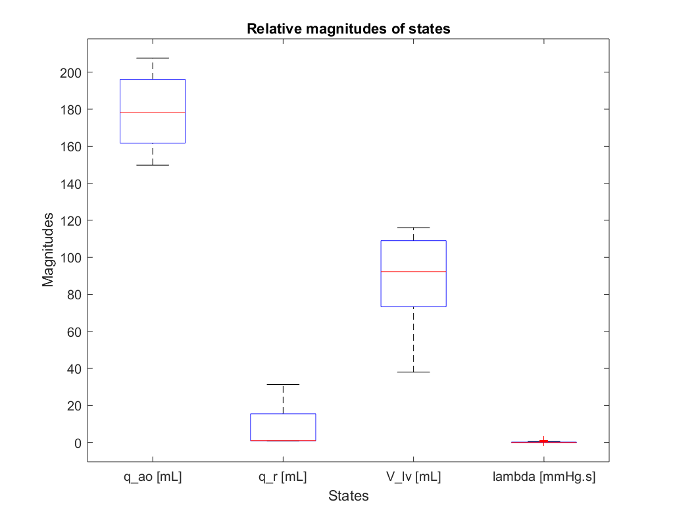
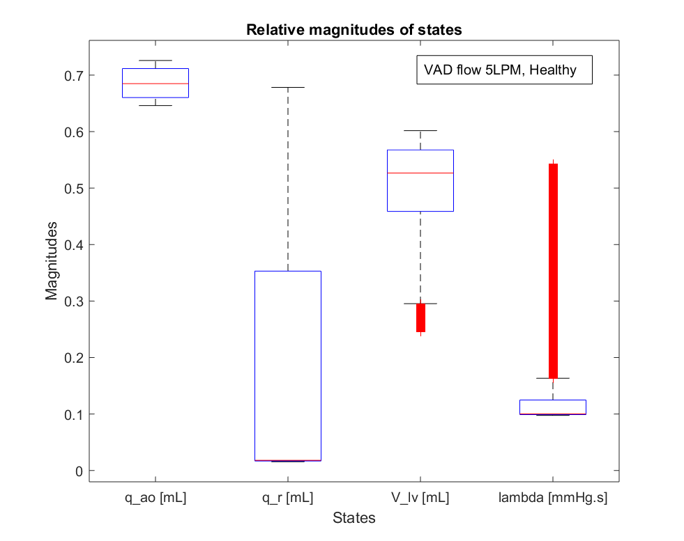
State magnitudes – better with scaling
Scaling

Slide 24
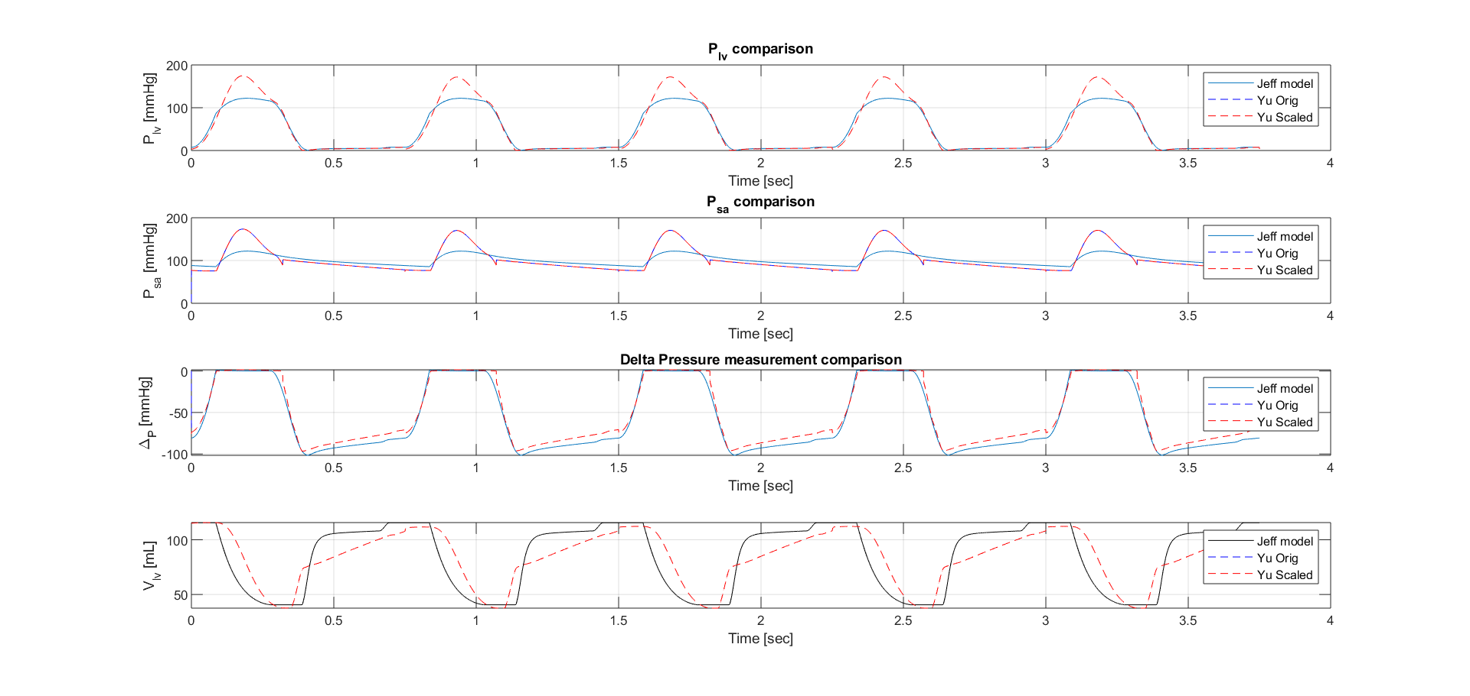

Comparison of outputs
Pressures have similar discrepency
$ΔP$ comparable

Slide 25
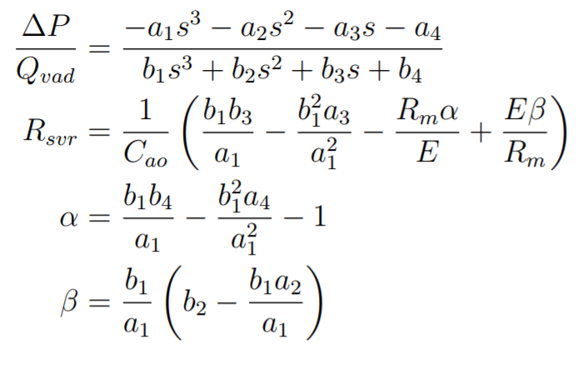
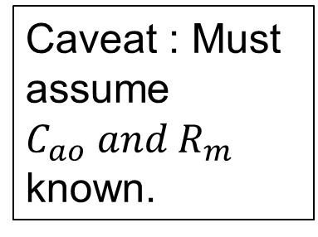

Identifiability analysis using Transfer approach shown in Yu’s dissertation
Caveat : Must assume $C_{ao} and R_{m}$ known.
Shows that $R_{svr}$ can be estimated

Slide 26
Emulation and Testing
Forward difference emulation
Testing of model under different step sizes
Testing with varying measurement rates

Slide 27
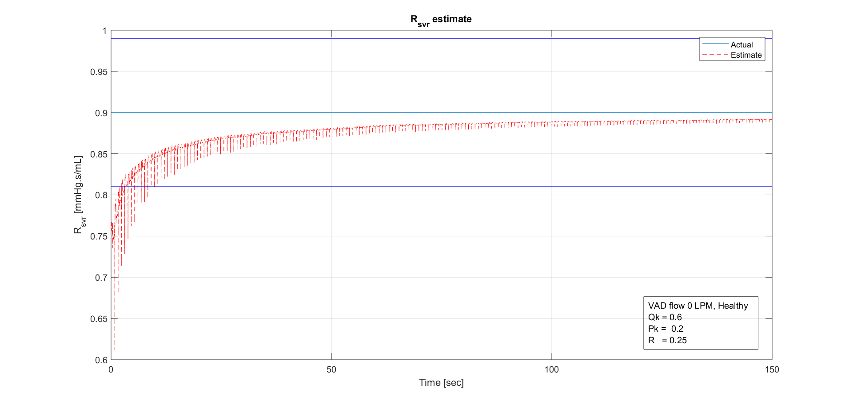
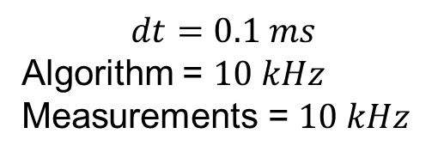
Lines for +/- 10% limits from base value
$$dt=0.1 ms$$
Algorithm = $10 kHz$
Measurements = $10 kHz$

Slide 28
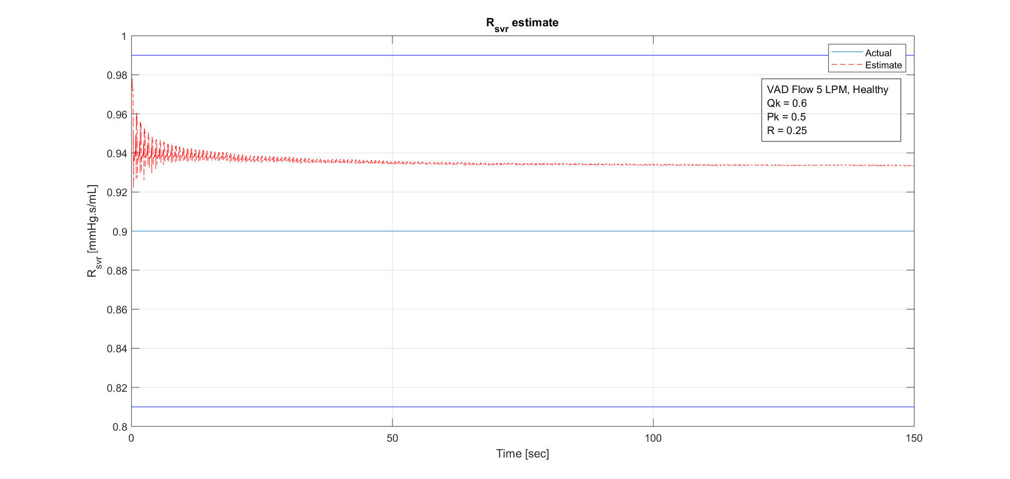
$$dt=0.1 ms$$
Algorithm = $10 kHz$
Measurements = $10 kHz$

Slide 29
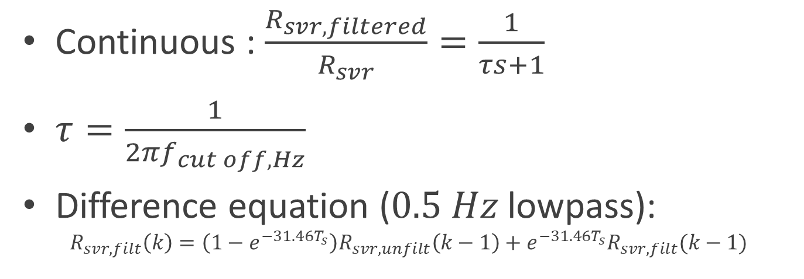
To remove spikes in estimate, implement low pass filter
Continuous : $\frac{R_{svr,filtered}}{R_{svr}}=\frac{1}{τs+1}$
$τ=\frac{1}{{2πf}_{cut off, Hz}}$
Difference equation ($0.5 Hz$ lowpass): $R_{svr,filt}\left(k\right)=\left(1−e^{−31.46T_{s}}\right)R_{svr,unfilt}\left(k−1\right)+e^{−31.46T_{s}}R_{svr,filt}(k−1)$
Tried with 1, 5, 0.5 Hz cutoffs
Using ZOH approximation
Sampling Time

Slide 30
Realistic algorithm rate and measurement rates (Based on Jeff’s email)
Algorithm – 5 kHz (Jeff email says 4.5)
Measurements – 500 Hz (worse case), 5 kHz (best case), (Jeff’s email says 450 Hz)

Slide 31
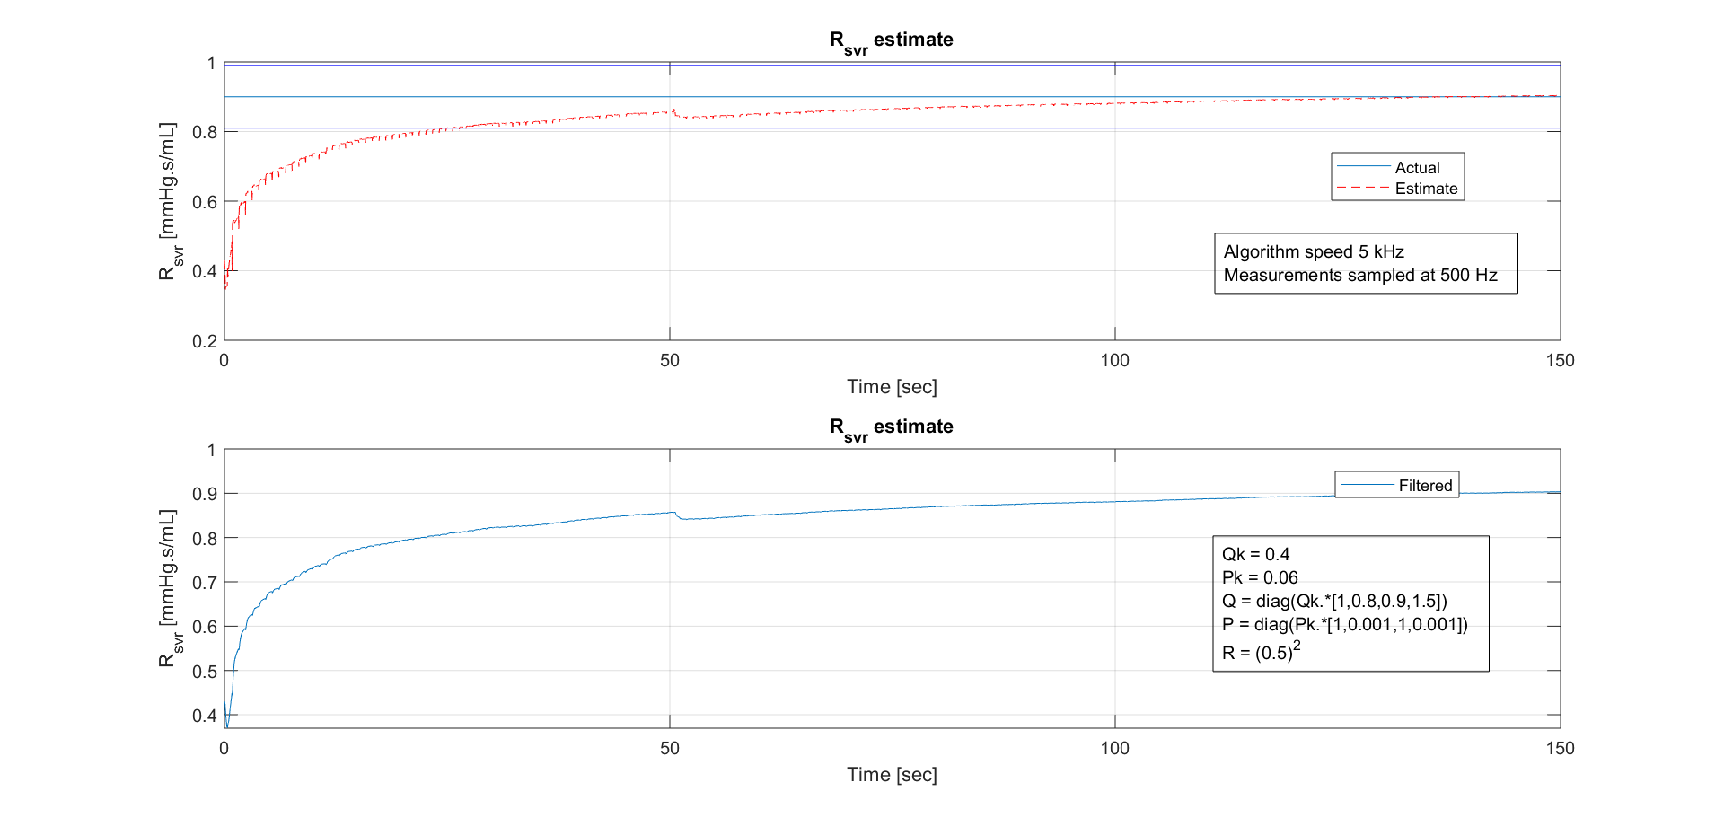

Slide 32
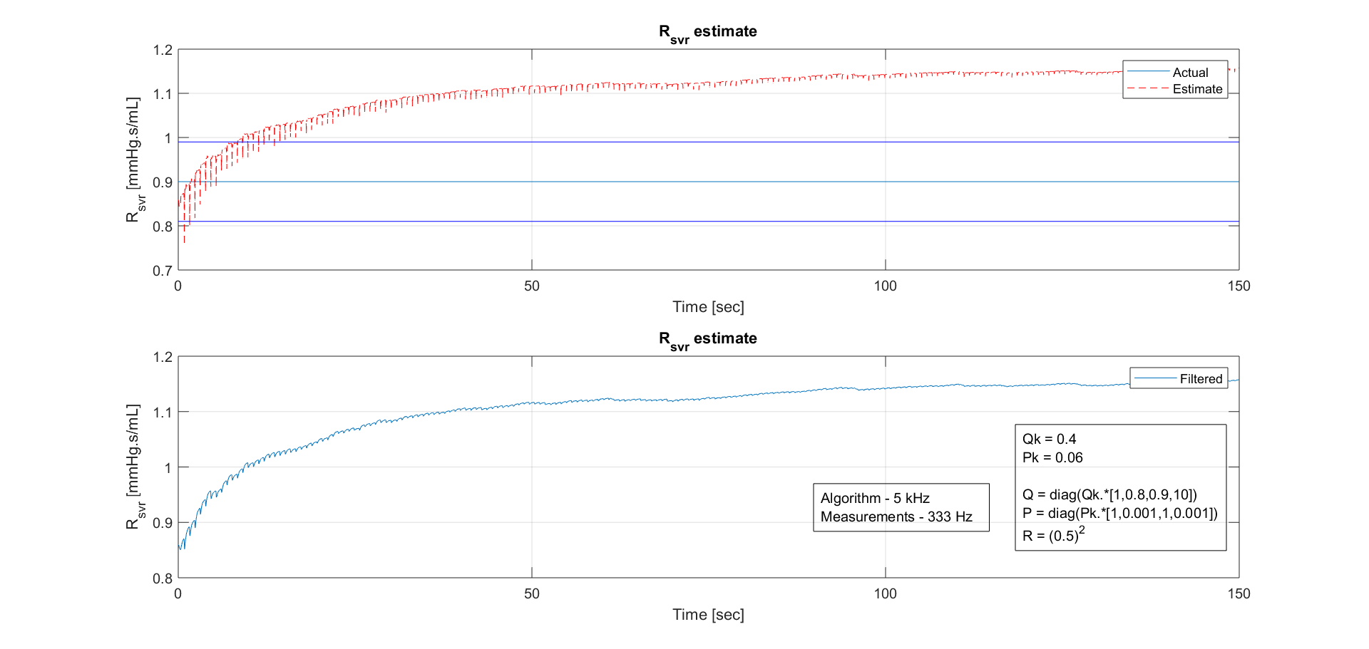
Limit of performance (degradation at 333 Hz measurements)

Slide 33
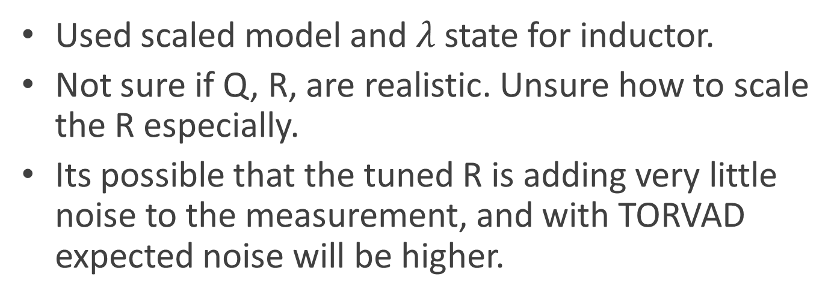
Discussion on Part 1
Used scaled model and $λ$ state for inductor.
Not sure if Q, R, are realistic. Unsure how to scale the R especially.
Its possible that the tuned R is adding very little noise to the measurement, and with TORVAD expected noise will be higher.

Slide 34
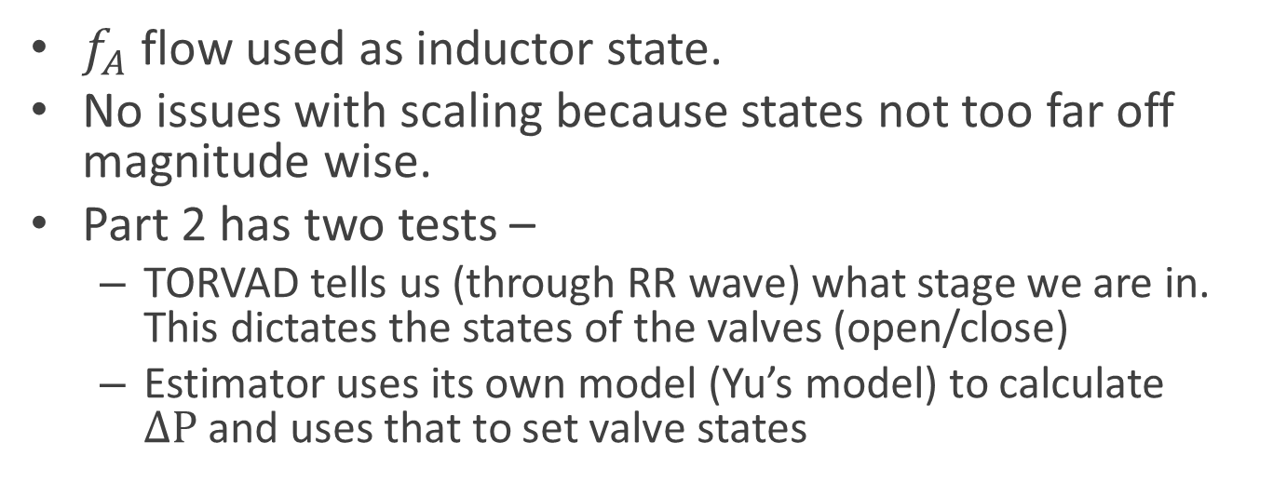
So, switched to Part 2
$f_{A}$ flow used as inductor state.
No issues with scaling because states not too far off magnitude wise.
Part 2 has two tests –
TORVAD tells us (through RR wave) what stage we are in. This dictates the states of the valves (open/close)
Estimator uses its own model (Yu’s model) to calculate $ΔP$and uses that to set valve states

Slide 35
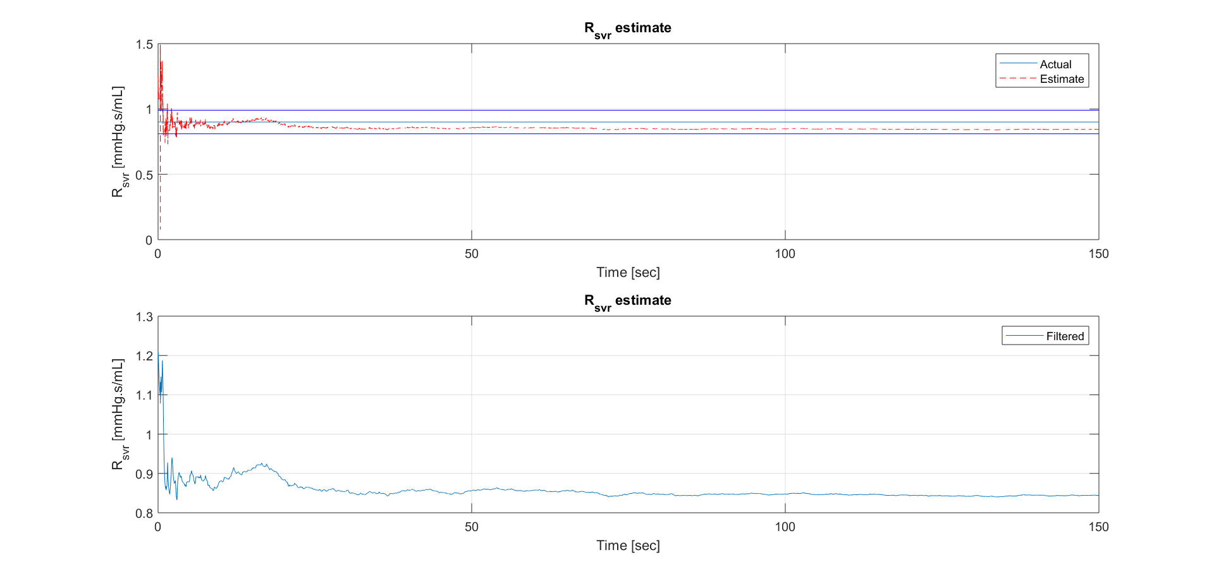
Part2 -> TORVAD dictates valve states, VAD off
Qk = 40
Pk = 800
Q = diag(Qk.*[1,1,1,1])
P = diag(Pk.*[1,0.001,1,0.01])
R = (5)^2
VAD Flow = 0 LPM
Algorithm 5 kHz
Measurements 500 Hz

Slide 36
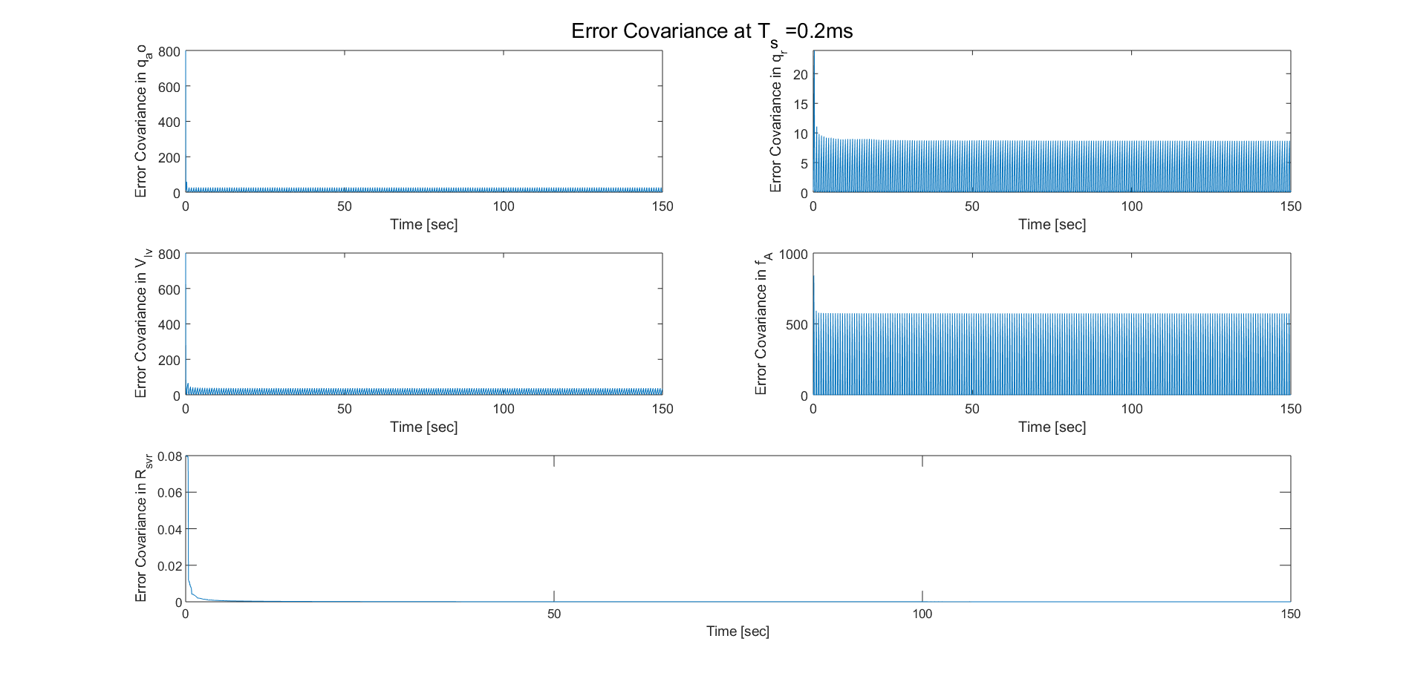
Part2 -> TORVAD dictates valve states, VAD off
Qk = 40
Pk = 800
Q = diag(Qk.*[1,1,1,1])
P = diag(Pk.*[1,0.001,1,0.01])
R = (5)^2
VAD Flow = 0 LPM
Algorithm 5 kHz
Measurements 500 Hz

Slide 37
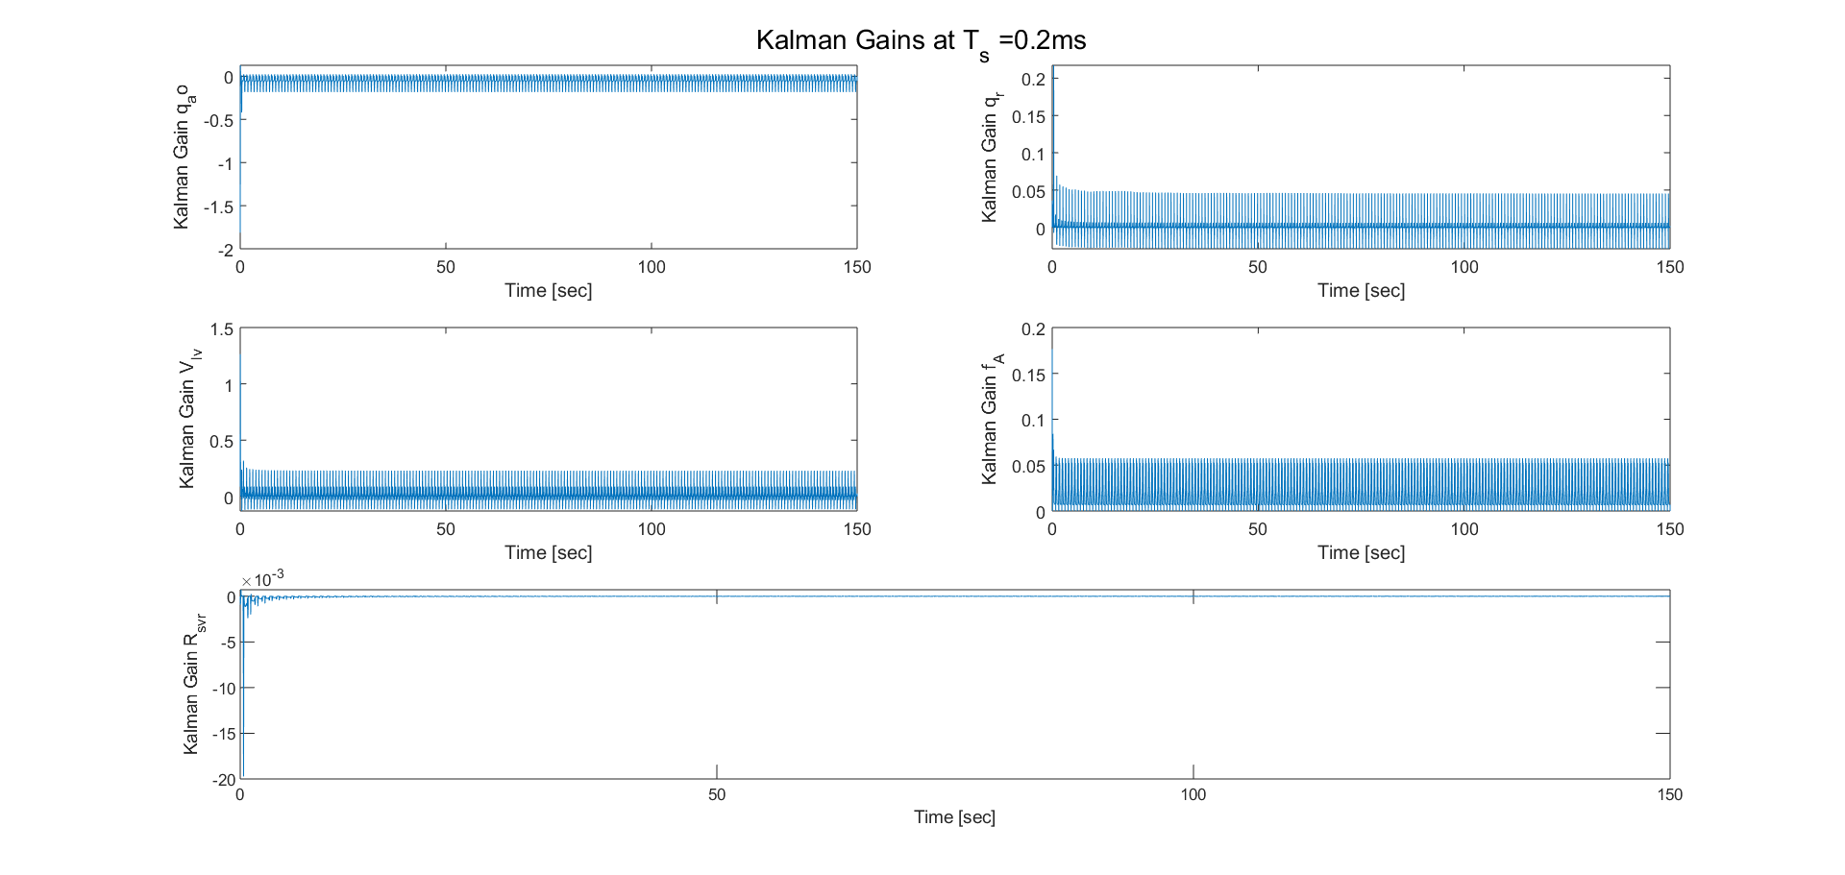
Part2 -> TORVAD dictates valve states, VAD off
Qk = 40
Pk = 800
Q = diag(Qk.*[1,1,1,1])
P = diag(Pk.*[1,0.001,1,0.01])
R = (5)^2
VAD Flow = 0 LPM
Algorithm 5 kHz
Measurements 500 Hz

Slide 38
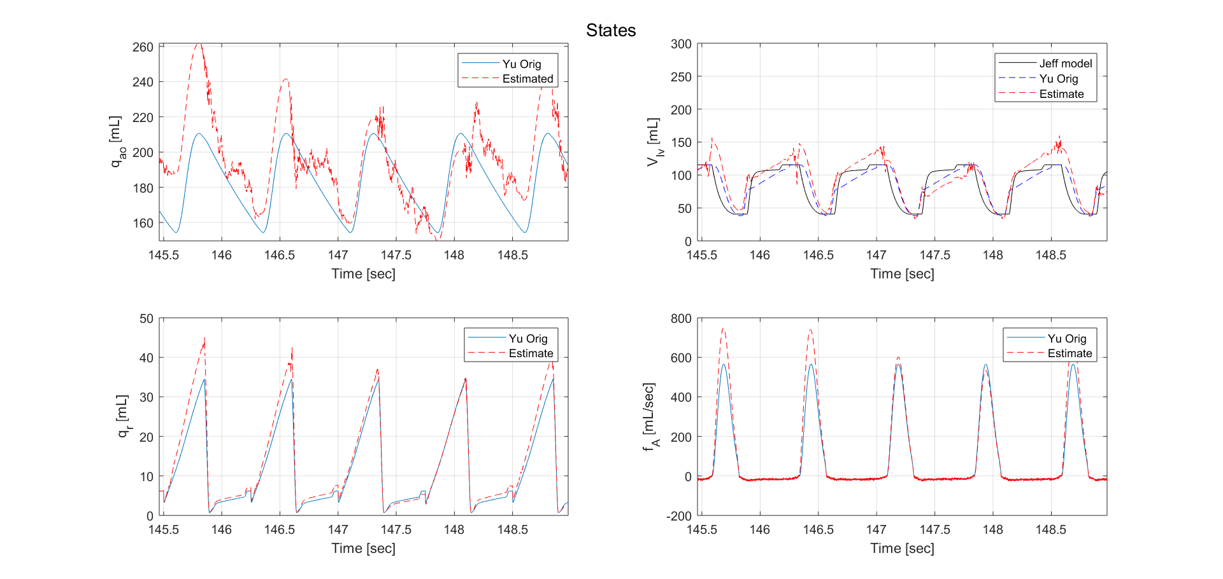
Part2 -> TORVAD dictates valve states
Ethan’s observability revealed that 1 state would not be observable. This could be that state. Luckily for us, looks like Rsvr is observable (in agreement with identifiability analysis)
Qk = 40
Pk = 800
Q = diag(Qk.*[1,1,1,1])
P = diag(Pk.*[1,0.001,1,0.01])
R = (5)^2
VAD Flow = 0 LPM
Algorithm 5 kHz
Measurements 500 Hz

Slide 39
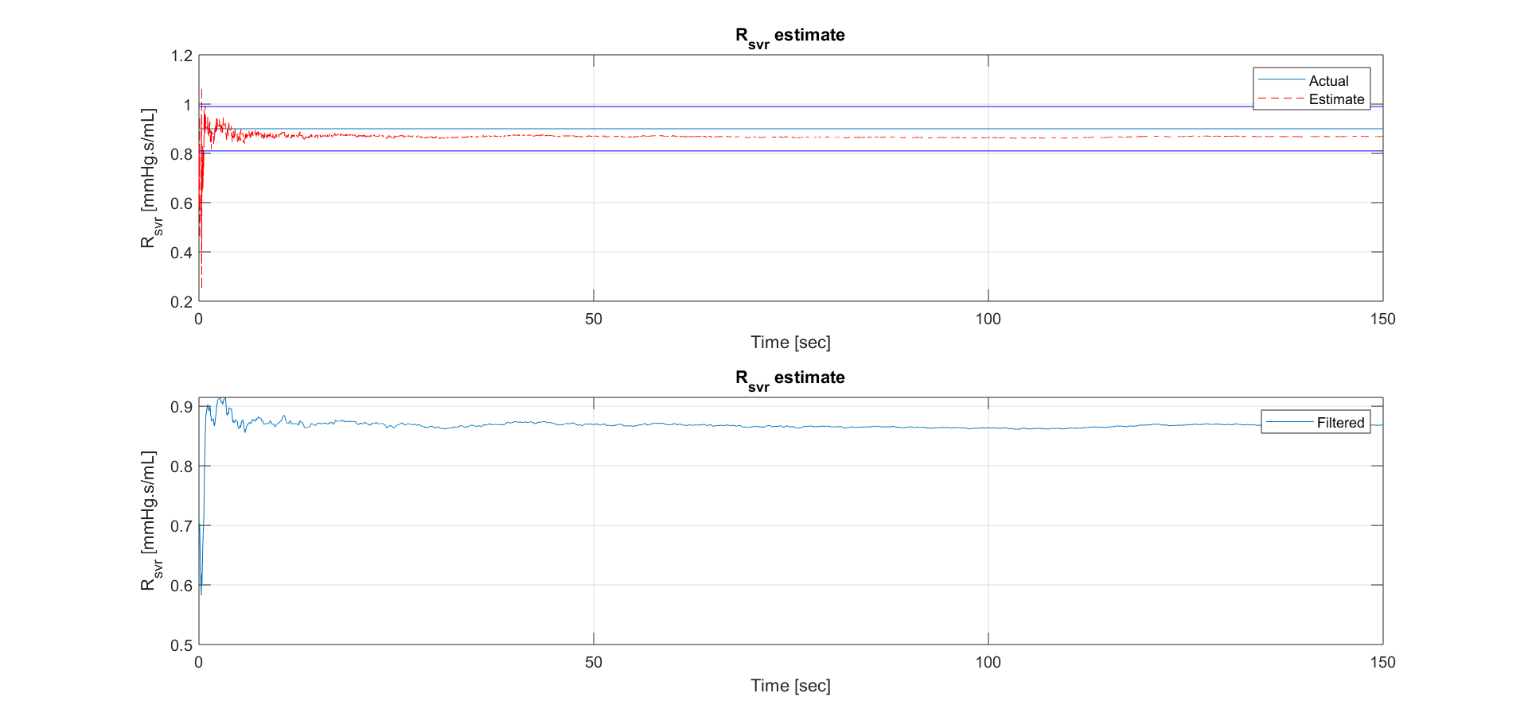
Part2 -> TORVAD dictates valve states, VAD on
Qk = 40
Pk = 800
Q = diag(Qk.*[1,1,1,1])
P = diag(Pk.*[1,0.001,1,0.01])
R = (5)^2
VAD Flow = 5 LPM
Algorithm 5 kHz
Measurements 500 Hz

Slide 40
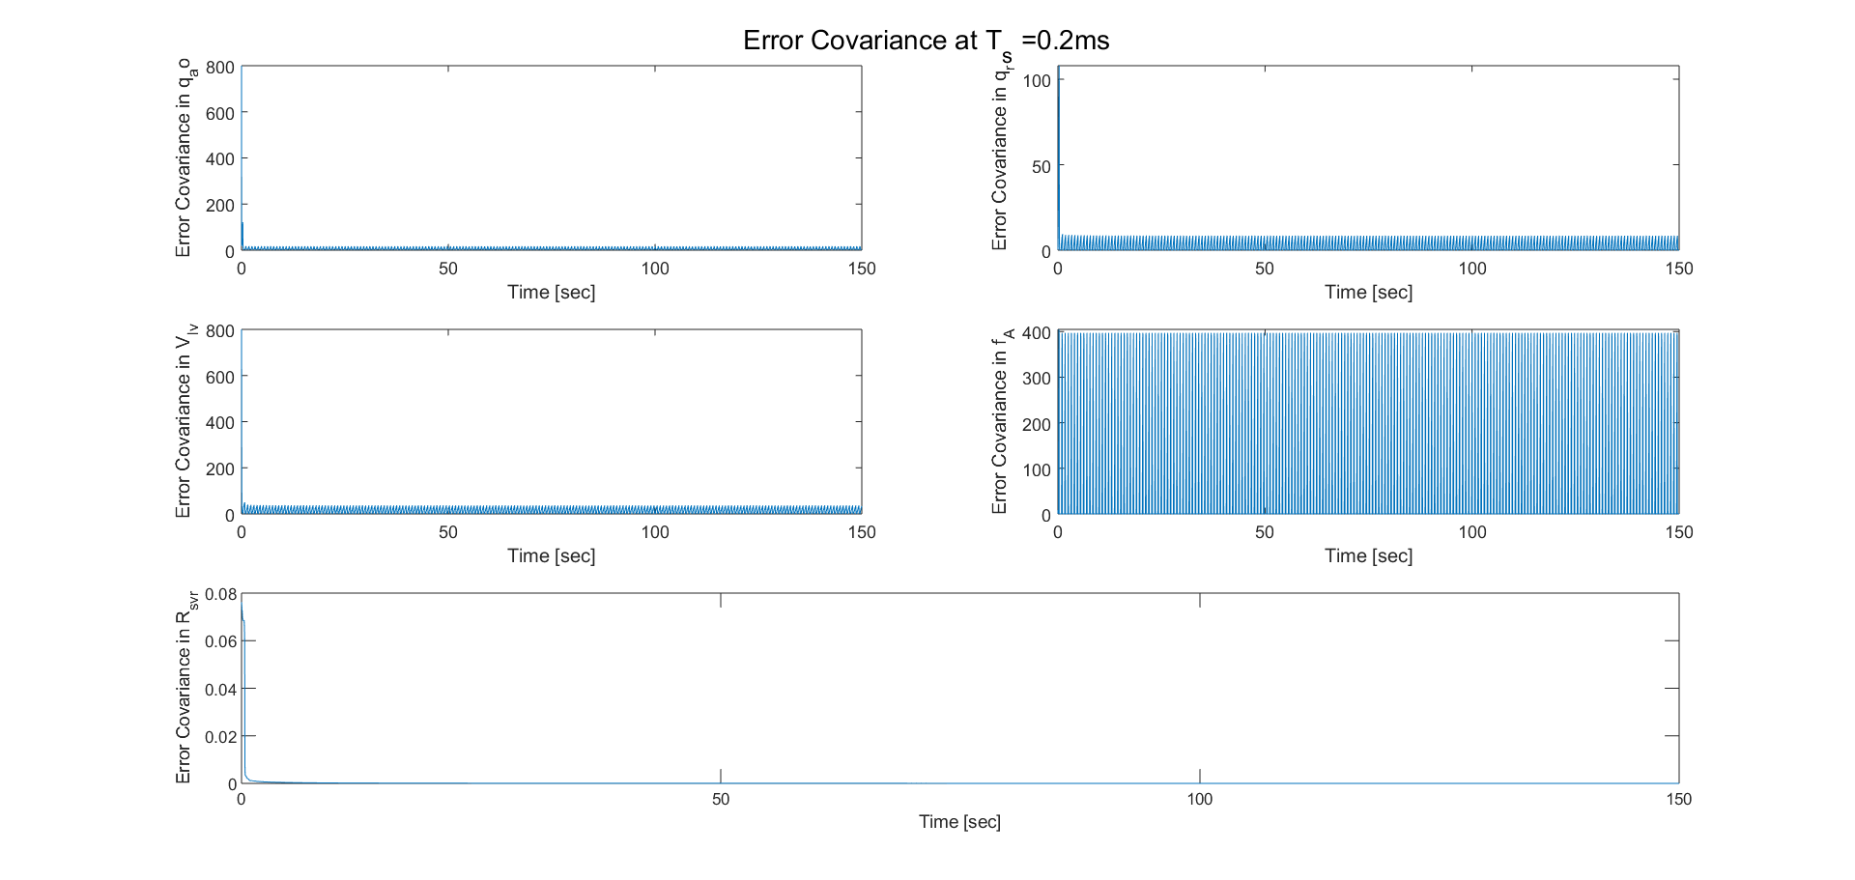
Part2 -> TORVAD dictates valve states, VAD on

Slide 41
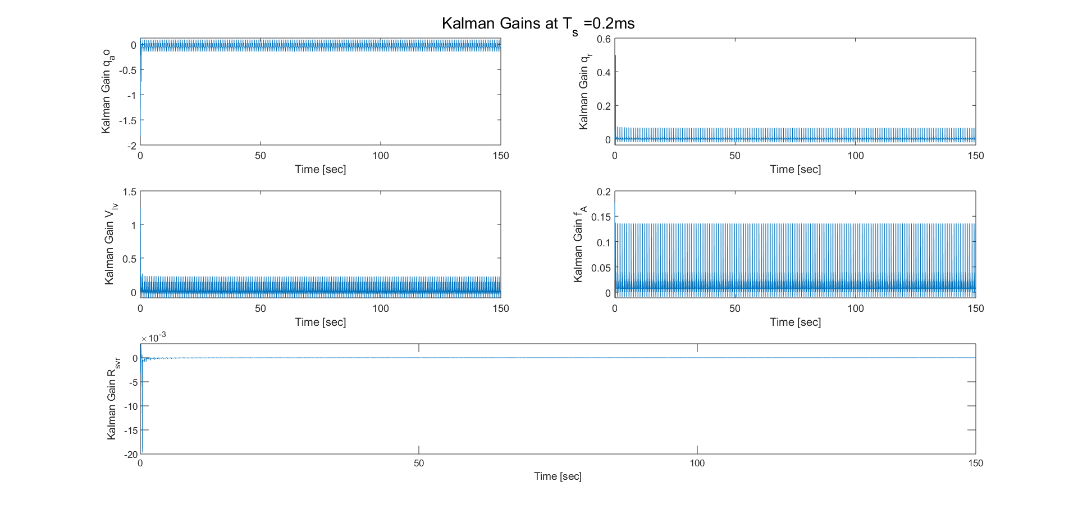
Part2 -> TORVAD dictates valve states, VAD on

Slide 42
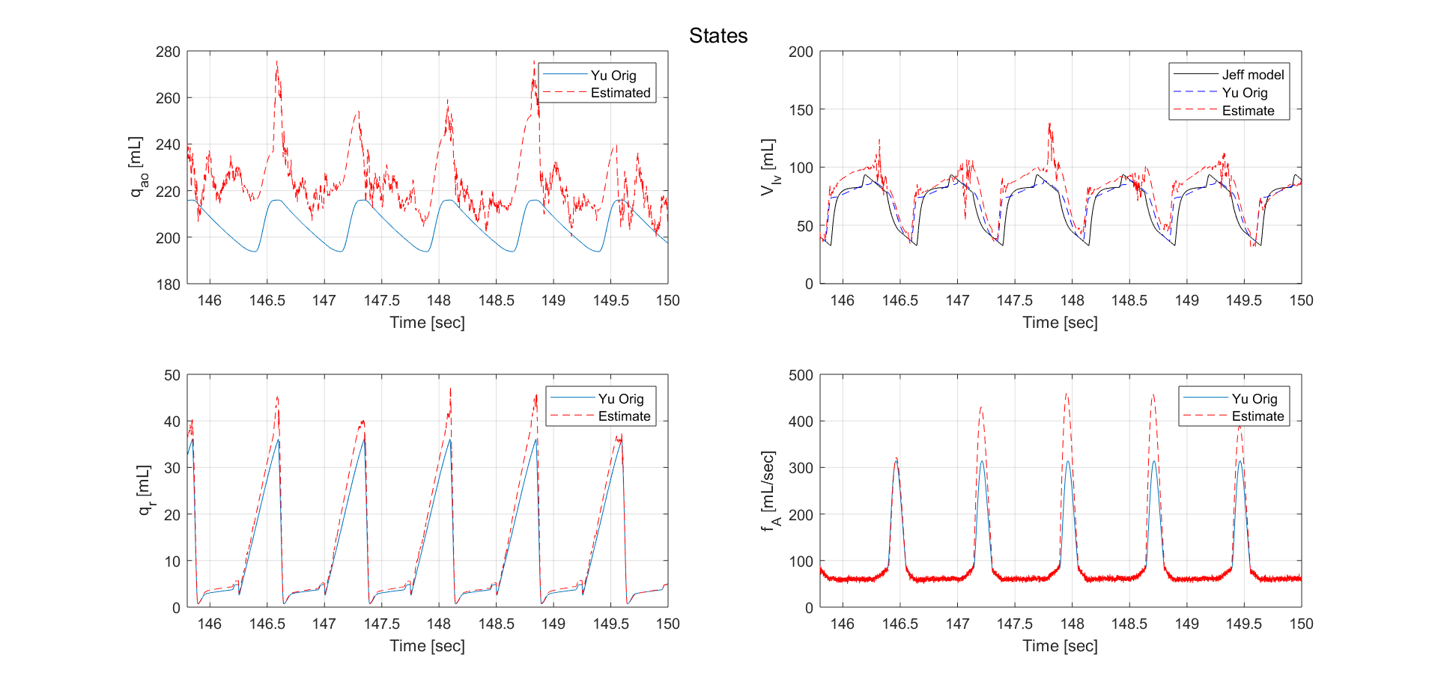
Part2 -> TORVAD dictates valve states, VAD on

Slide 43
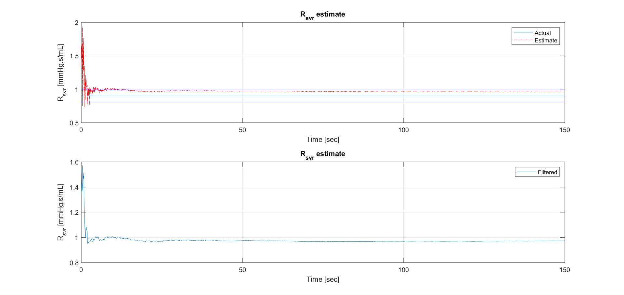
Part2 -> Estimator switches valve states, VAD on
Qk = 40
Pk = 800
Q = diag(Qk.*[1,1,1,1])
P = diag(Pk.*[1,0.001,1,0.01])
R = (5)^2
VAD Flow = 5 LPM
Algorithm 5 kHz
Measurements 2.5 kHz

Slide 44
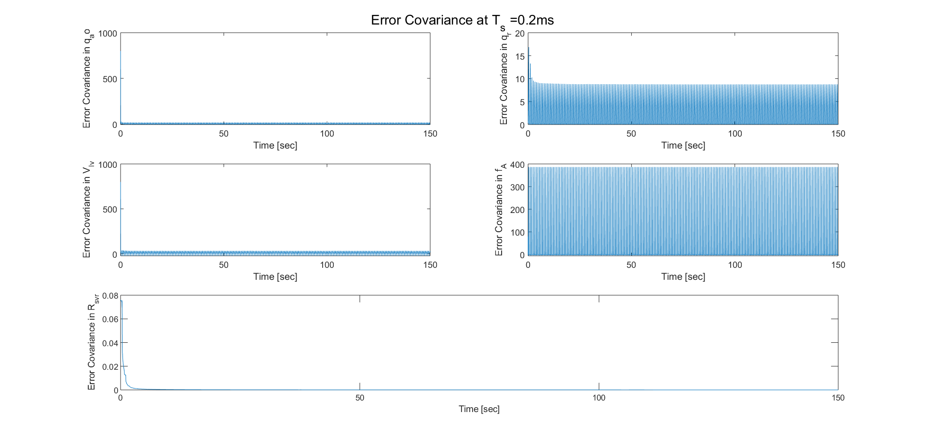
Part2 -> Estimator switches valve states, VAD on
Qk = 40
Pk = 800
Q = diag(Qk.*[1,1,1,1])
P = diag(Pk.*[1,0.001,1,0.01])
R = (5)^2
VAD Flow = 5 LPM
Algorithm 5 kHz
Measurements 2.5 kHz

Slide 45
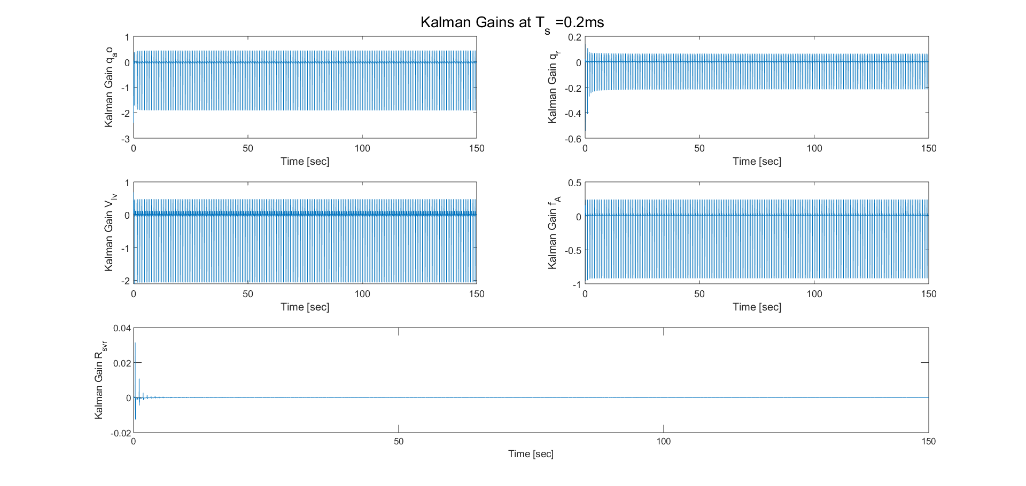
Part2 -> Estimator switches valve states, VAD on

Slide 46
Part2 -> Estimator switches valve states, VAD off
Qk = 40
Pk = 800
Q = diag(Qk.*[1,1,1,1])
P = diag(Pk.*[1,0.001,1,0.01])
R = (5)^2
VAD Flow = 0 LPM
Algorithm 5 kHz
Measurements 2.5 kHz

Slide 47
Part2 -> Estimator switches valve states, VAD off

Slide 48
Part2 -> Estimator switches valve states, VAD off

Slide 49
Observations
Part 2 with TORVAD telling when to switch valves (from RR wave, or some other timing procedure) gives best performance. Able to work with 5kHz algorithm rate, 500 Hz measurements.
Part 2 with estimator deciding when to switch valves needs more frequent measurements. Even then, it fails sometimes. Example of failure in next slide.

Slide 50
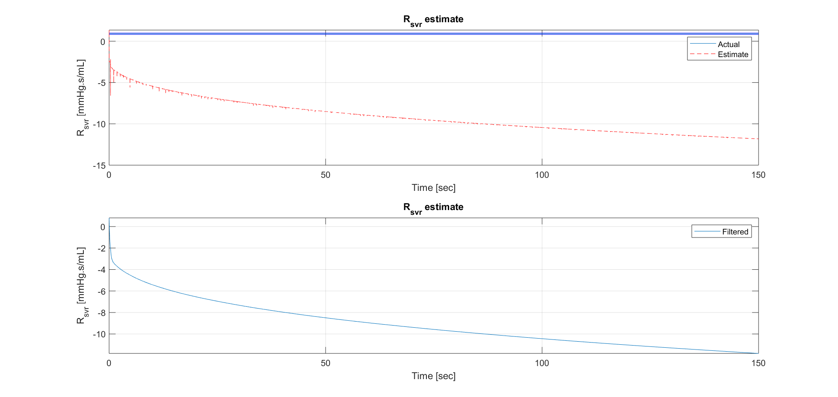
Failed estimation with Part 2 approach 2

Slide 51
Another key point
In all approaches so far, I am using Qvad measurements at each iteration. Even if the measurements are available at a lower rate, I cannot do without Qvad measurements because they are used in the model equations.
This is where including a Qvad state will help, so that you can use the model to propagate the Qvad, and use measurements (even if sparse), to correct it.
This assumption is justified in my simulations because the VAD is assumed to be providing continuous flow anyways. So I could use a noisy measurement at all iterations.

